Slide 1
Welcome
to
Ethiopian Textile Industry Development Institute
2015

Slide 2
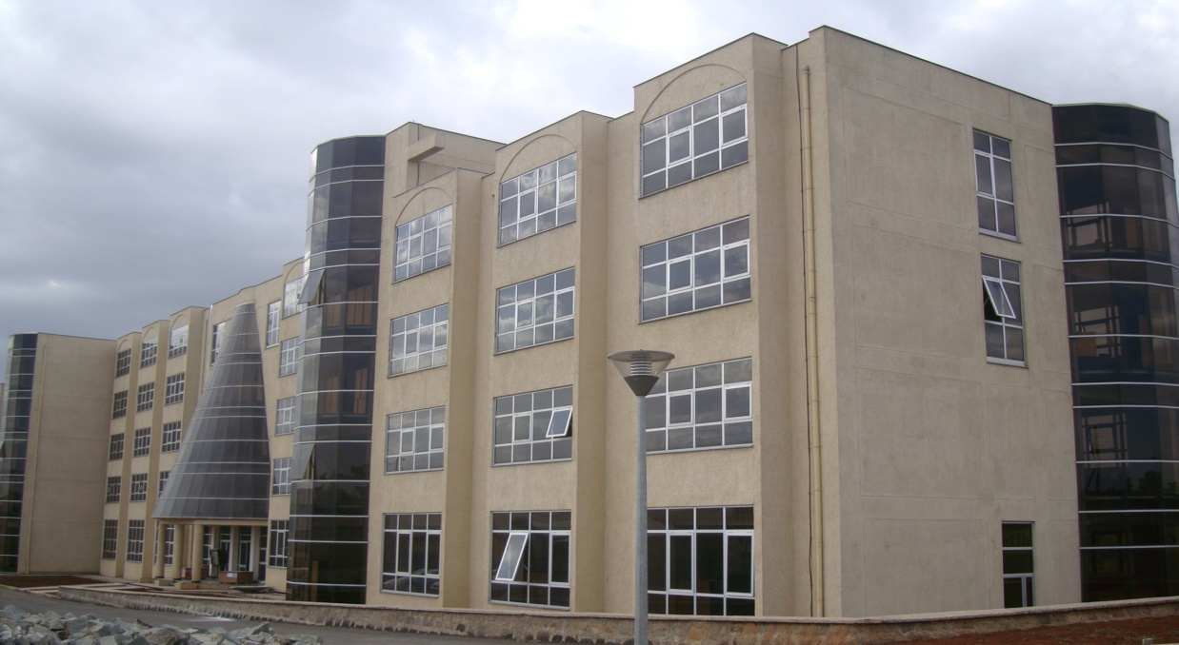
ETIDI OFFICE

Slide 3
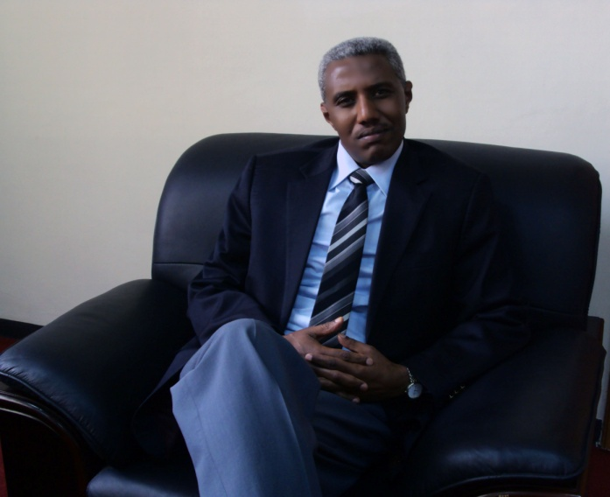
Ato Sileshi Lemma, Director General of the Institute
Address of the institute
ETIDI is located at Akaki Kality sub city . It is 1.5 k.m far away from the Main Office of the Sub City to South-West and it is next to the Ethiopian Leather Industry Development Institute. It is 20 minute drive from Bole International Airport.

Slide 4
Establishment of ETIDI
ETIDI, the Institute that Unlocks the Future of Ethiopian Textile Industry
ETIDI is established following the implementation of the Industrial Development Strategy.
It is established on the 7th June 2010 pursuant to Council of Ministers Regulation No.180/2010.
Enabling the Ethiopian textile industry to be competent in the global market by promoting and supporting investment, providing consultancy service and training, conducting research and development activities and giving laboratory inspection and marketing support. Organized along the textile value Chain

Slide 5
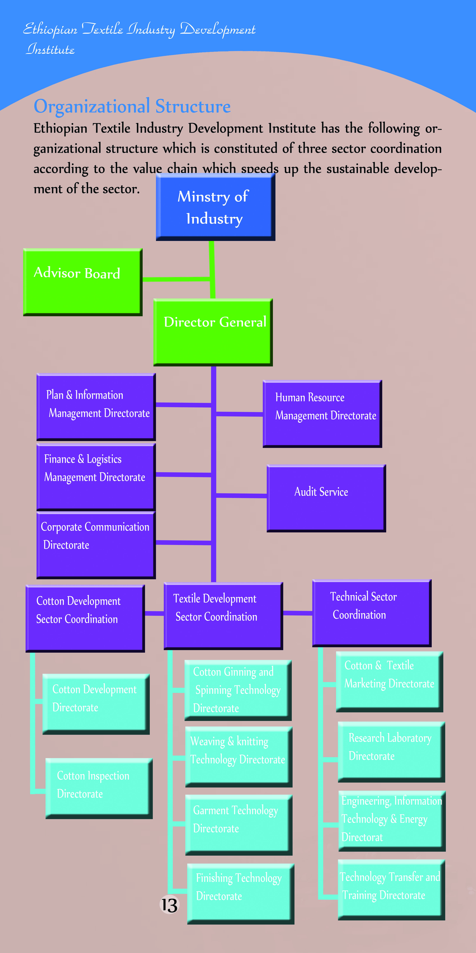

Slide 6
Ethiopian Textile Industry Development Institute’S Staff profile
Educational level | Employees
 | M | F | T
MSc/MA | 17 | 2 | 19
BSc/BA | 128 | 29 | 157
Diploma | 24 | 29 | 53
Certificate | 0 | 0 | 0
Grade 12 and below | 14 | 39 | 53
Total | 206 | 76 | 282

Slide 7
The Role of ETIDI
Objective:- Enabling the Ethiopian textile industry to be competent in the global market through investment support, production capacity building and marketing support.
Mission :- Enabling the Ethiopian textile industry competent in the global market by providing sustained investment expansion, consultancy, training research and development laboratory and marketing support and services.
Vision :- We aspire to be a world-class institute that enables the Ethiopian textile industry competitive in the global market.
ETIDI is organized along the textile value Chain

Slide 8
3. Values of the institute
We strive for the success of the investors development
We are ever ready to learn and positive change
We work for accelerated technology transfer
We stand for carrying and protecting the environment
We shall implement successful and integrated working system
We move forward for fair participation and benefit

Slide 9
Main Supports and Services of ETIDI
ETIDI provides complete and full-fledged supports and services to the textile industry in Investment, Production and Marketing Supports.
These includes:-
Investment focused supports and Services
Collecting, analyzing, documenting and disseminating of information in regard to the sector’s investment.
Conducting feasibility studies for the sectors investment.
Consultancy services in technology selection and negotiation, construction, installation, commissioning and testing for the investors.
Facilitating up until they convert into operational phase

Slide 10
Capacity building(production)
Training, benchmark implementation, laboratory testing and inspection, R & D, Certification of quality standards etc.
Technical consultancy and supports by availing local and foreign experts
Support in quality assurance and certification
Market supports and Services
Marketing capacity building ( through training and consultation).
Securing input supply and strengthening intra- Industrial linkage on raw material supply.
Promotion and expansion of market destination of Ethiopian textile and apparel manufacturers product.
Import and export process facilitation.
Sect oral development policy initiation.

Slide 11
Facilities of etidi
Fully equipped training facilities
Model spinning factory (under progress)
Model weaving and knitting factory (under progress)
Finishing facilities (under progress)
Design and Garment training classes and facilities
Modern chemical and physical laboratories
Fully equipped library.

Slide 12
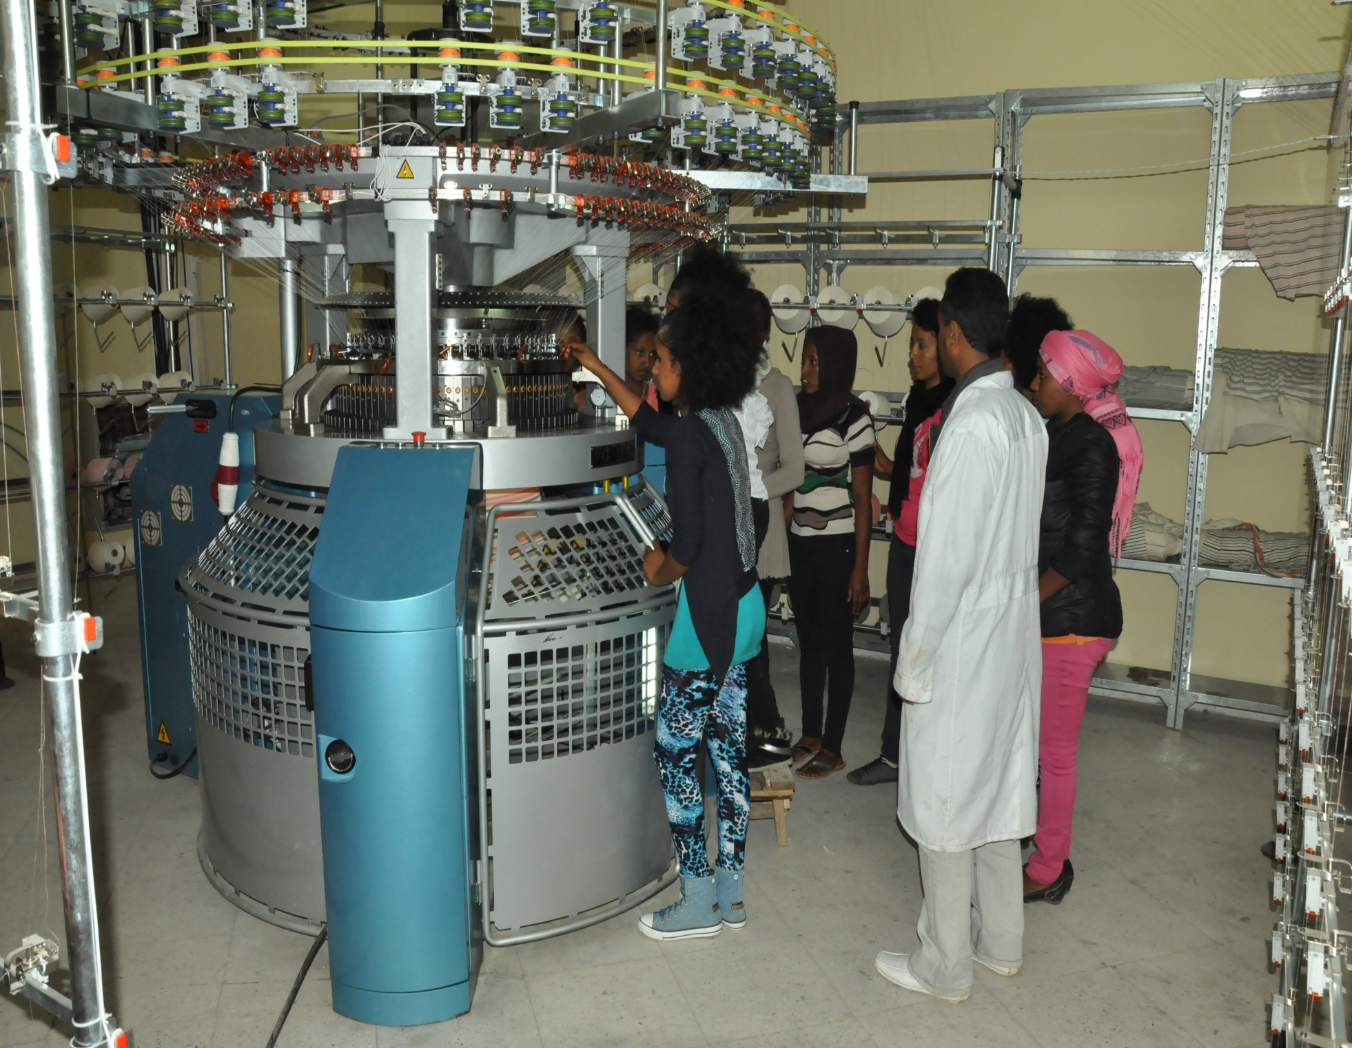
Trainees in the Kniting workshop

Slide 13
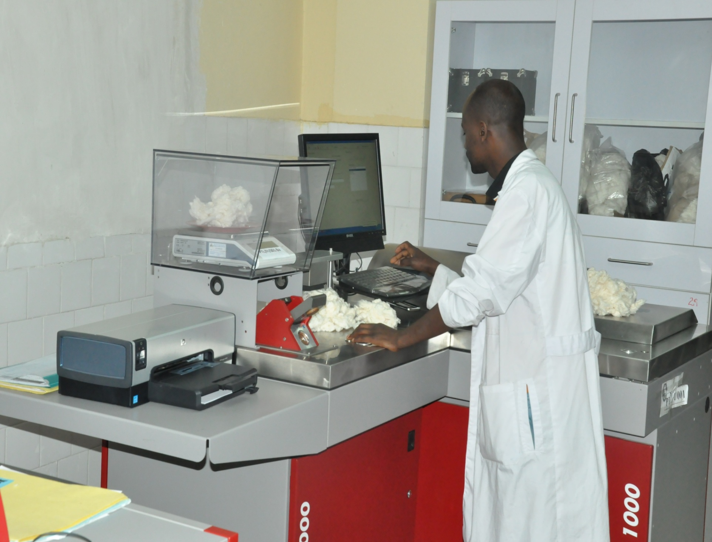
Cotton testing laboratory

Slide 14
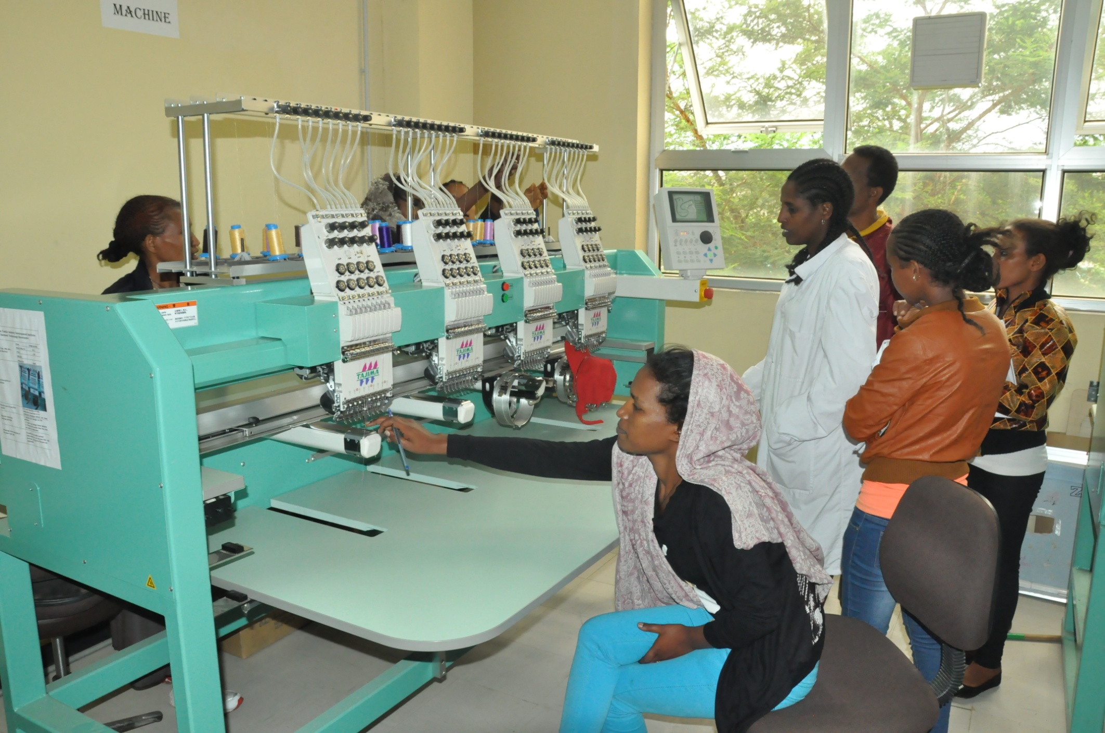
Trainees in the embroidery workshop

Slide 15
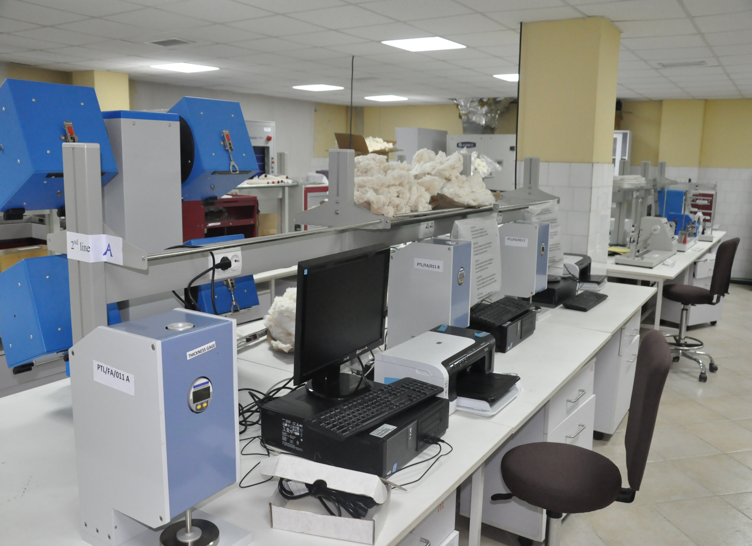
Fiber, yarn and fabric physical proprieties testing laboratory

Slide 16
Number of Operational Textile and Garment Factories as Per to the Value Chain
S. No. | Area of Operation | Number of Factories
1 | Ginning | 18
2 | Integrated Textile Mills | 20
3 | Spinning | 5
4 | Weaving and/or Knitting | 12
5 | Handloom (medium size) | 6
6 | Dyeing and Printing | 3
7 | Blanket Factory | 6
8 | Garment Factory(knitted/woven) | 60
 | Total | 130

Slide 17
Projects Under Investment Process
No | Name of Company | Investor’s Citizenship | Product Type | Status
1 | Karl International | India | Garment | Rented Shade in Bole Lemi Industry Zone and will start operation soon
2 | Gulf Textile | Pakistan | Garment | Rented Shade in Bole Lemi Industry Zone and will start operation soon
3 | Velocity | India | Garment | Undergoing process to start project in Mekele
4 | Experience Clothing | Pakista | Garment | Undergoing process to get land in Addis Ababa
5 | Dima Faiweiwei | Ethio-China | Spinning | Operational
6 | Shin TS Com | Korea | Garment | Rented Shades in Bole Lemi Phase 2
7 | Jay Jay mills | India | Garment | Rented Shades in Bole Lemi Phase 2
8 | SVP | India | Spinning | Finalizing bank process and will soon start construction
9 | Green Valley | India | Spinning | Will soon start construction
10 | New wide Garment | Taiwan | Garment | Rented Shades in Bole Lemi Phase 2
11 | Shin TS | Korea | Garment | Rented Shades in Bole Lemi Phase 2
12 | Atraco |  | Garment | Rented Shades in Bole Lemi Phase 2
13 | Myungsung | China | Garment | Rented Shades in Bole Lemi Phase 2
14 | Akper | Turkey | Integrated | Taken land in Ejere, Oromia and starting bank process

Slide 18
OUR Links
ETIDI has made different stipulation to create a mutual cooperation on the prioritize areas of interest among the following International Institution and/or organizations
International Links
National Institute of Fashion Technology (NIFT) of India
Institute of Chemical Technology (ICT) of India
Indian Institute of technology (IIT)
Ethio-Korean cooperation

Slide 19
Domestic Links
The Institute has ardently working to outreach domestic Universities, TVET Institutes and Small and Micro Enterprises through human resource development, conducting demand driven problem solving researches, providing consultancy services and market linkage. We are also working on strengthening Textile University-Industry linkage forum. Among them Addis Ababa, Bahirdar, Diredawa, Hawasa and Axum are the principal corridors of the forum.

Slide 20
The major market potential for Ethiopian Textile and apparel Manufactures
Ethiopia enjoys easy access to various markets under bilateral and multilateral arrangements such as the African Growth and Opportunity Act (AGOA), Everything But Arms (EBA) , the Common Market of Eastern and Southern Africa (COMESA) and More than 16 bilateral agreement.

Slide 21
Cooperation Areas with Italian partners
1. Attraction of Investment in Cotton Farming, Textile and Garment Industry.
2. Market linkage between Ethiopian Textile and Garment Manufacturers and Italian buyers.
3. Capacity Building in Cotton Farming, Textile and Garment Industry Management.
4. Technological skill up-grading in Textile and Garment Industry.

Slide 22
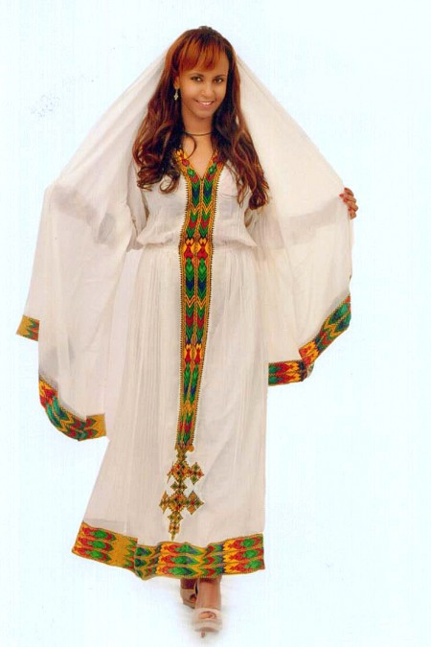
Thank you!

